Slide 1


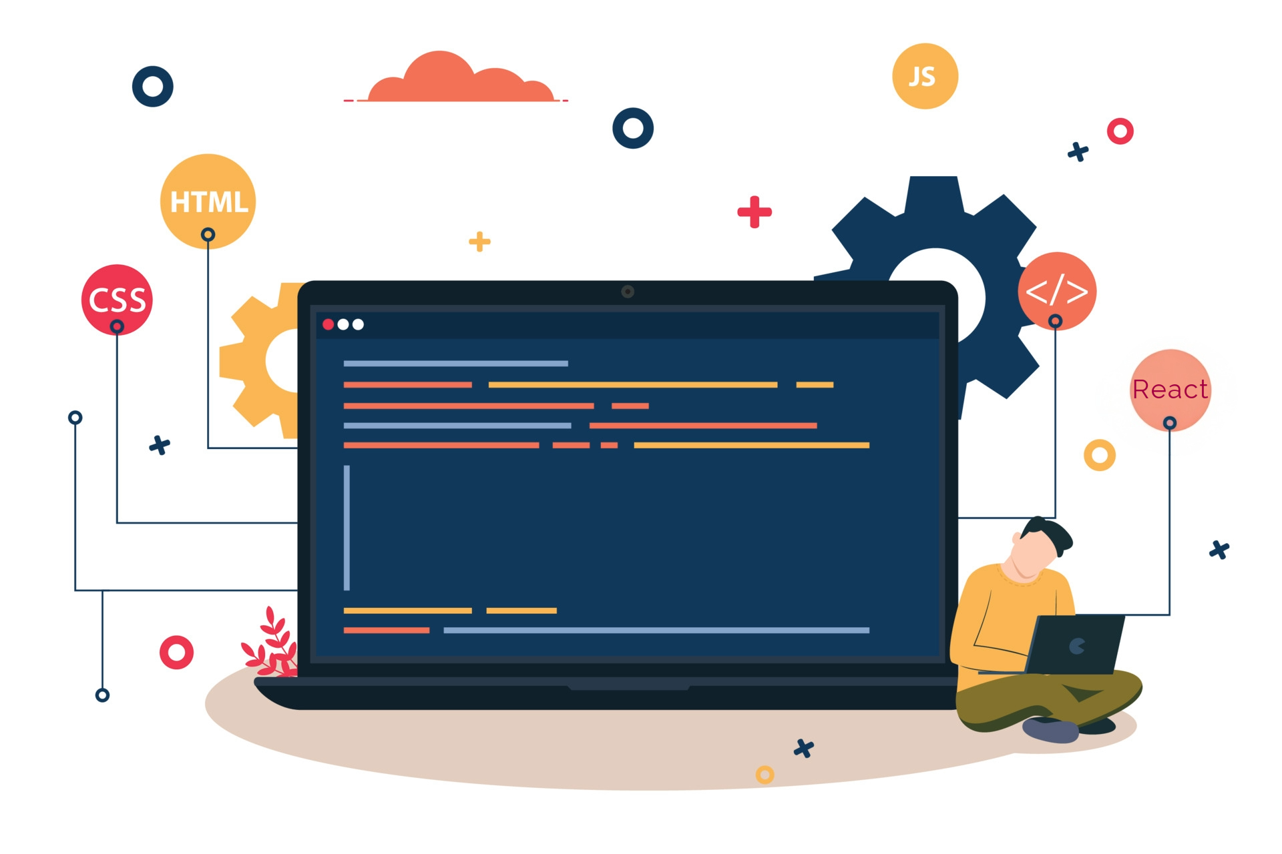



Lecture 19:
Introduction to React
Course - Web Development - II
-By
Instructor Name
welcome@krmangalam.edu.in
Sohna Road,Gurugram,Haryana 122103

Slide 2

| Table of Contents
React Overview
React vs Angular vs Vue
Why Choose react?
References.
The End.

Slide 3

|
What if your entire Instagram page reloaded every time you liked a photo?

Slide 4
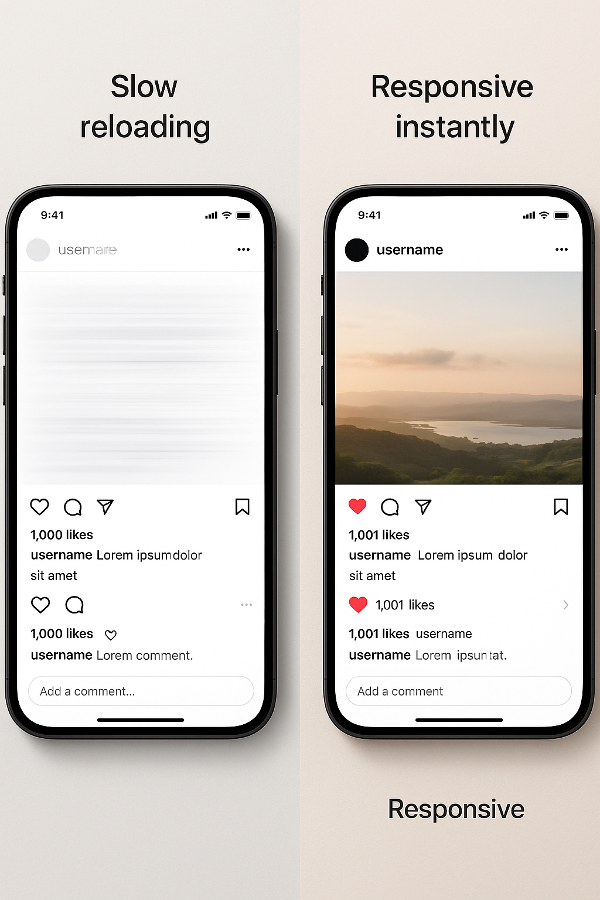
|
What if your entire Instagram page reloaded every time you liked a photo?
That would be slow and frustrating — reloading the whole page just to like a post.
React fixes this by updating only the part that changes, like the like button, making apps feel fast and smooth — just like Instagram or Facebook.

Slide 5
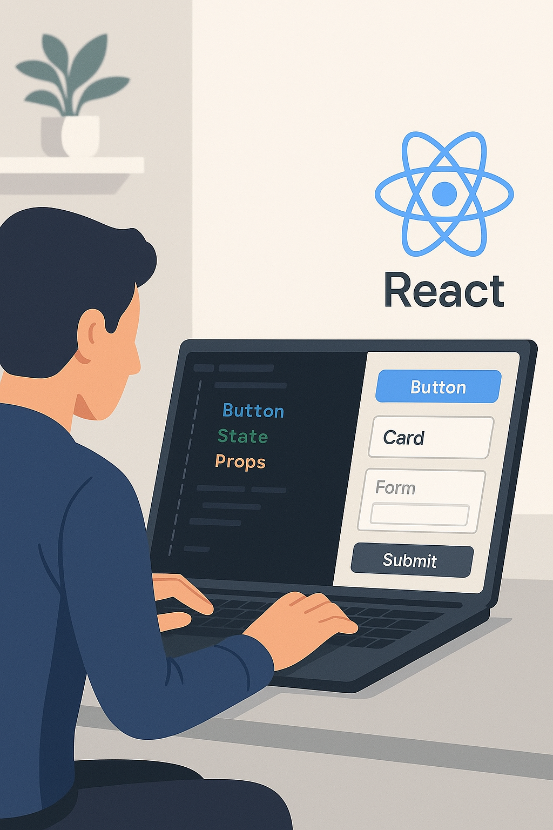
| What is React?
React is a JavaScript library for building user interfaces, developed by Facebook and released in 2013.
It is not a complete "framework" because it only handles the "view" layer of an application. You choose your own tools for routing, state management, etc.
React helps developers build dynamic, responsive, and interactive user interfaces without unnecessary reloads — and that’s why it's one of the most popular JavaScript libraries in the world.

Slide 6
| Imperative vs Declarative
Imperative (jQuery/vanilla JS): You tell the computer how to do something, step-by-step. "Find this element, then change its text, then add this class."
Example : You call the pizza place and give them step-by-step instructions: "Preheat your oven, roll the dough, spread the sauce, add cheese, add pepperoni, bake for 15 minutes...
Declarative (React): You tell React what you want the UI to look like for a given state, and React figures out the "how" for you. "If the user is logged in, the UI should show a 'Logout' button. If not, show a 'Login' button."
Example : You just call and say, "I want a large pepperoni pizza." You describe the final state you want and trust the chef (React) to handle the steps to get there.

Slide 7
| REACT VS ANGULAR VS VUE
Feature | React | Angular | Vue
Type | Library (focuses on UI) | Framework (full-featured) | Framework (progressive, lightweight)
Language | JavaScript + JSX | TypeScript (mostly) | JavaScript (optionally TypeScript)
Learning Curve | Easy to start, harder for large apps | Steep (lots of concepts) | Moderate, easy to pick up
Data Binding | One-way binding (mostly) | Two-way binding | Two-way binding
DOM | Virtual DOM | Real DOM (but can use change detection) | Virtual DOM

Slide 8
| REACT VS ANGULAR VS VUE
Feature | React | Angular | Vue
Community & Popularity | Very big, backed by Facebook | Big, backed by Google | Growing, popular in Asia
Best For | Interactive UI components | Large enterprise apps | Small to medium apps, flexible
Size | Small | Large | Small

Slide 9
| Why we use React?
1. Builds Dynamic UIs Easily :
React makes it easy to create apps that update in real-time — like liking a post, adding items to a cart, or typing in a search bar — without reloading the page.
2. Component-Based
Architecture :
You can build your UI using reusable components — like buttons, cards, or forms — and manage them separately. It’s like using Lego blocks to build complex structures.
3. Fast and Efficient :
React uses a Virtual DOM to update only the parts of the page that change, making your app faster and smoother.

Slide 10
| Why we use React?
4. Developer-Friendly :
Its syntax (JSX), tools, and community make it easy to write, debug, and maintain code — even as your app grows.
5. Huge Ecosystem & Job
Demand :
React is supported by a massive ecosystem of libraries (like React Router, Redux) and is in high demand in the job market.

Slide 11

| Check Your Understanding
Question : What is React?
Options : a) A complete web framework that includes a server and database.
b) A JavaScript library for building user interfaces.
c) A programming language that compiles to JavaScript.
d) A CSS pre-processor for styling components.
Answer : b) A JavaScript library for building user interfaces.
Explanation:
React is specifically a library focused on the "View" layer of an application. It helps developers build interactive and reusable UI components.

Slide 12
| References
W3Schools – JS Tutorial : Beginner-friendly JS tutorials with examples and interactive editors. 🔗 https://www.w3schools.com/react
react.dev - A comprehensive, tutorial-style website that deeply explores core React concepts, including components, state, effects, and hooks, through interactive examples and in-depth explanations.
🔗https://react.dev/

Slide 13
Thanks
For
Watching
Course - Web Development - II
welcome@krmangalam.edu.in
Sohna Road,Gurugram,Haryana 122103

